Slide 1
Gears

Slide 2
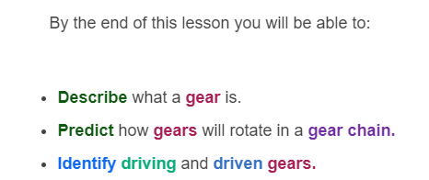
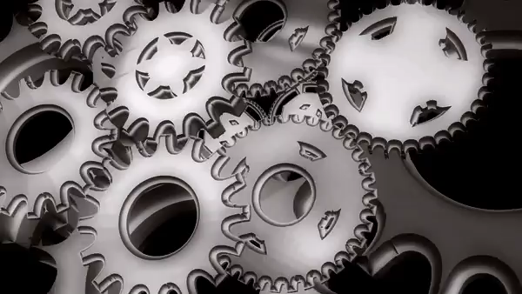

Slide 3
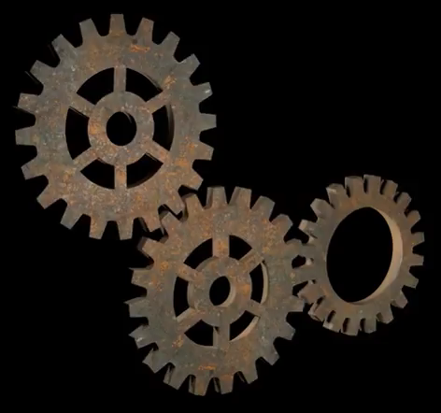
A gear is quite similar to a wheel, but it has teeth too!
A gear wheel is a wheel with teeth around its edge. The teeth of one gear can fit into the teeth of another.
This means you can make a whole row or train of gears whose teeth are interlocking. This is also called a transmission.

Slide 4
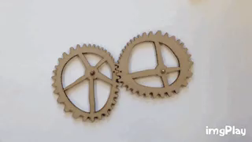
Gears provide us with a mechanical advantage.
Gears are a way of using one wheel to turn another. They move mechanical power from one gear to another using rotational force.

Slide 5
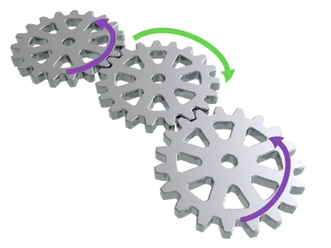
Gear wheels always move in an opposite direction to each other.
If you have two gear wheels together, and you make one of the wheels move, the other one will move in the opposite direction.
That means if one gear rotates clockwise, the other must rotate anti-clockwise.

Slide 6
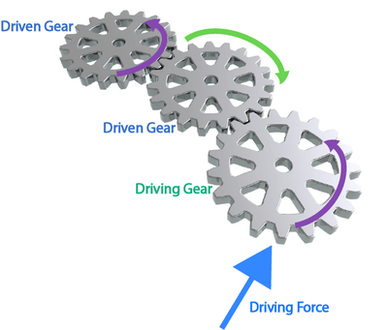
One gear out of a gear chain always has to have a force applied to it so it can turn.
The gear wheel that you (or some other driving force) make move is called the driving gear.
The other gear wheel that moves as a result of this is called the driven gear.

Slide 7
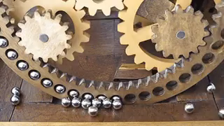
When we use a set of gears together, the force or speed of the driven gear can be increased.
When we use two gears in a row we can increase either the force delivered by the driven gear or the speed which the driven gear rotates at.

Slide 8
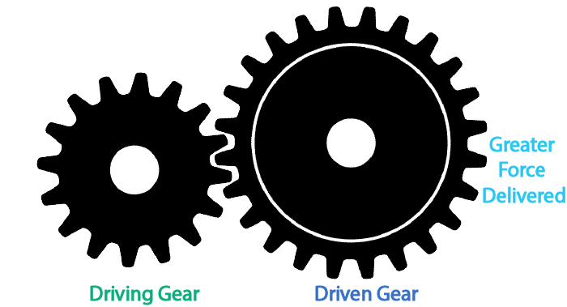
The force and speed changes in the driven gear are always related to the size of the driving gear.
If the driving gear is smaller than the driven gear, the driven gear will deliver a larger force.
However, the gear will rotate slower.

Slide 9
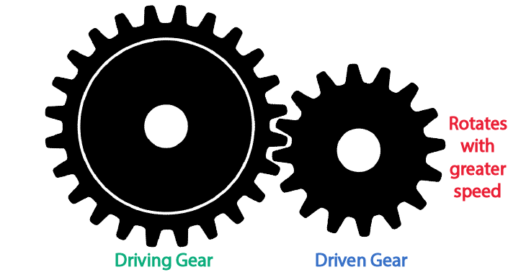
Remember, the change in size of the driving gear is always relative to the size of the driven gear.
When the driving gear is larger than the driven gear, the driven gear will rotate faster.
However, this means that the driven gear will deliver less force.

Slide 10
Gears provide us with a mechanical advantage by increasing either speed or force.
Gears are a little bit similar to levers. When we increase the distance between the effort and the fulcrum (pivot) on a lever, we decrease the amount of force required to lift the load.
If we increase the size of a driven gear relative to the size of the driving gear, we will increase the force that the driven gear outputs. This is because the distance from the centre of the gear to the teeth on the driven gear is larger.

Slide 11
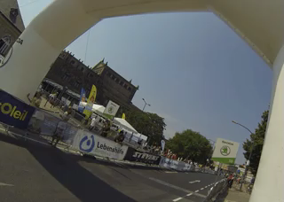
Gears are really useful because we can choose whether we want to increase the force output or the speed output.
Motorbikes and bicycles are very common examples of gears being used to change the output speed. When you want to cycle faster along a flat road, you change your gears so you have to apply more force, but you increase your speed.
This is because the size of the driving gear has increased compared the driven gear, and so the driven gear rotates faster but delivers less force.

